Slide 1

MS Software Engineering
Data Science Cohort 2021
Artificial Intelligence enabled Image Generation from text

Slide 2


Problem
To generate image given text description
Caption text can consist of multiple objects (Usually <= 5)
“A child is playing with a ball on a lawn”

Slide 3
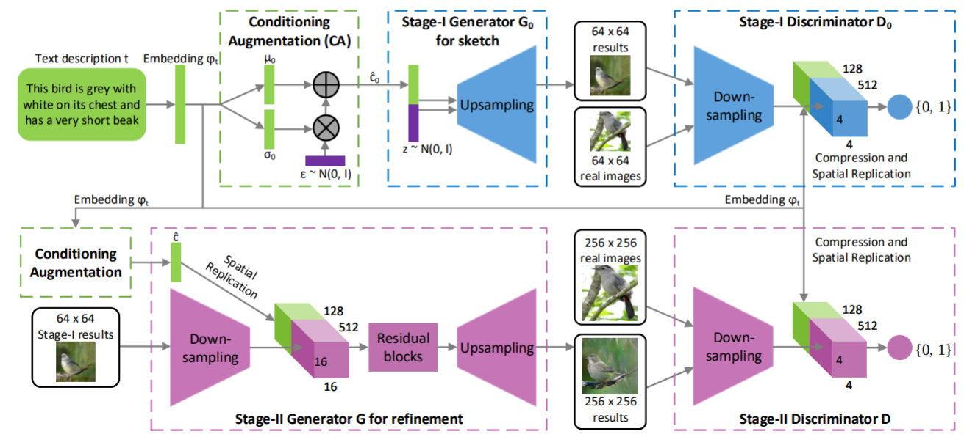
Previous Work StackGAN
Two main ideas:
Mutli-Scale Architecture
Conditioning Augmentation
Reference -https://arxiv.org/abs/1612.03242
Notes:
Stacked GAN

Slide 4
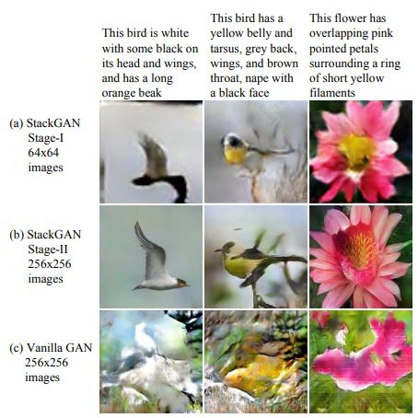
Previous Work StackGAN's Multi-Scale Architecture
Stage I produces a 64 x 64 images
Stage II takes Stage I's output as conditional input to produce 256 x 256 images
Reference -https://arxiv.org/abs/1612.03242
Notes:
Stacked GAN

Slide 5
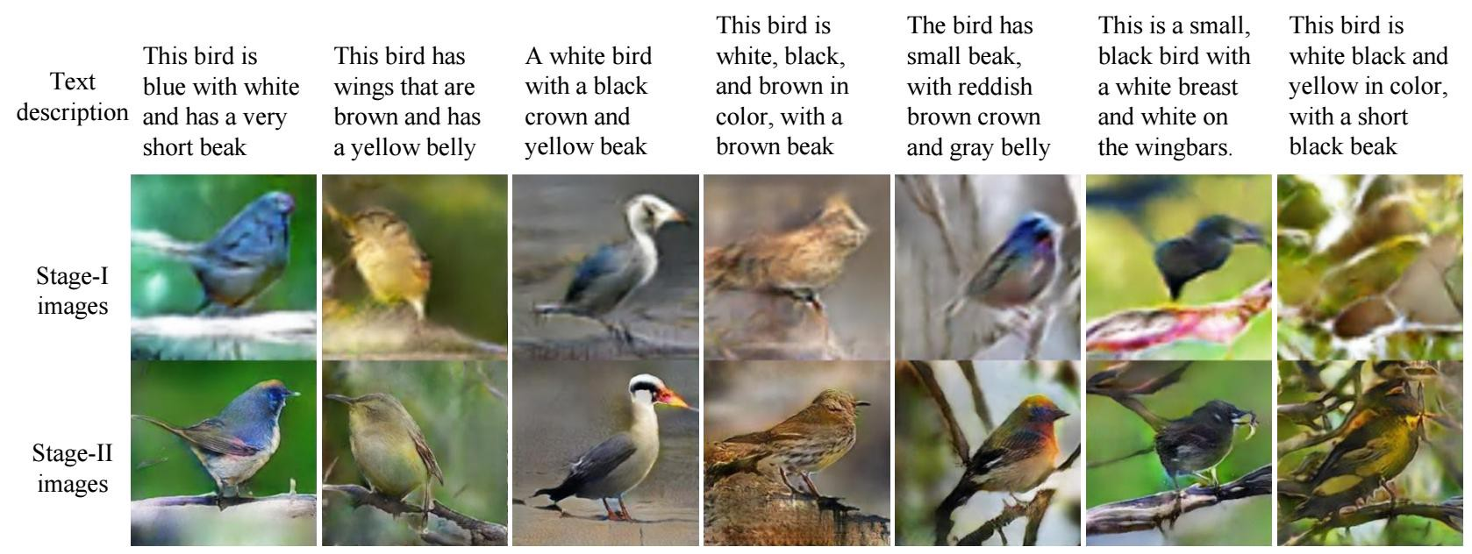
Previous Work StackGAN's Stage I and Stage II results
Reference -https://arxiv.org/abs/1612.03242
Notes:
Stacked GAN

Slide 6
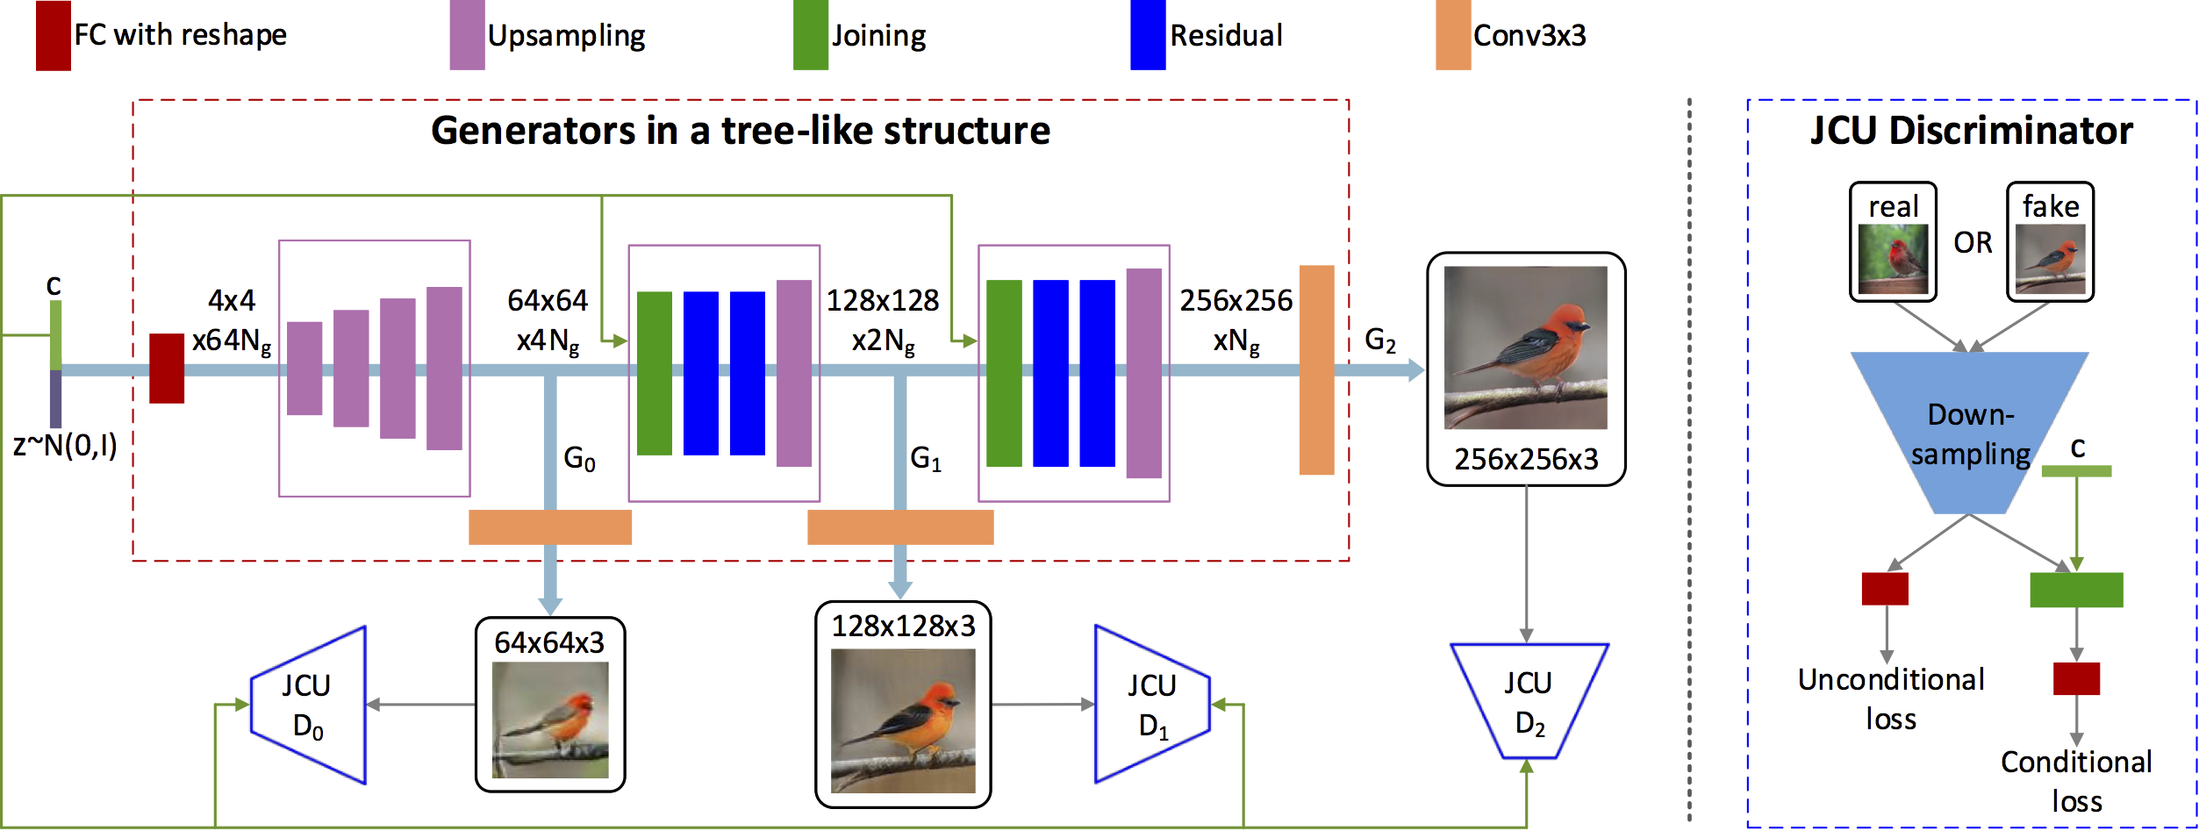
Previous Work StackGAN++
Adds multiple Generators-Discriminators pairs.
Trains all Generators jointly.
Adds a "color-consistency" regularization for the generator.
Reference -https://arxiv.org/abs/1710.10916

Slide 7
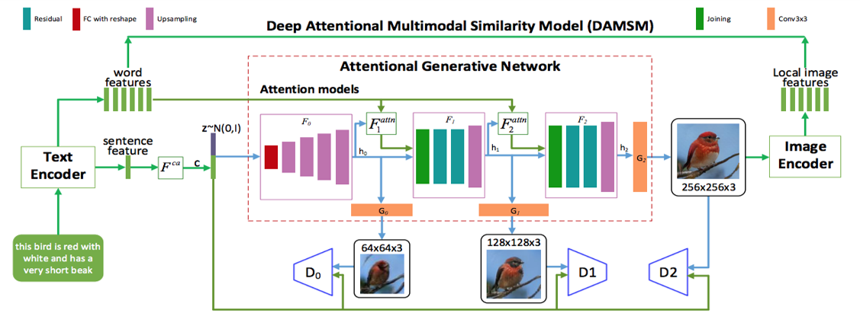
Previous Work AttnGAN
The contribution of the AttnGAN can be divided into two parts:
Attentional Generator Network
Deep AttentionalMultimodal Similarity Model (DAMSM)
Reference - https://arxiv.org/abs/1711.10485

Slide 8
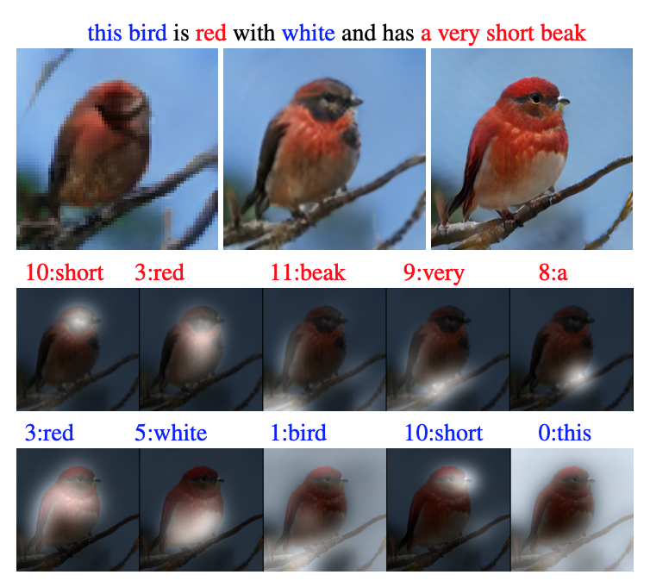
Previous Work AttnGAN
Reference - https://arxiv.org/abs/1711.10485

Slide 9
​
Summary of Previous Work
1. GANs can generate realistic looking images adhered to characteristics of textual description. 2. The networks are conditioned on an embedding of textual description. 3. This approach has led to good results on simple, well-structured data sets containing a specific class of objects (e.g., faces, birds, or flowers) at the image center.

Slide 10
What if textual description and images become more complex?
For instance, ​ - More than one object​ - Large variety in background and scenery

Slide 11
Object Pathway-GAN
Focuses specifically on individual objects.
Generates these objects at meaningful locations in the image simultaneously generating a background that fits with the overall image description

Slide 12
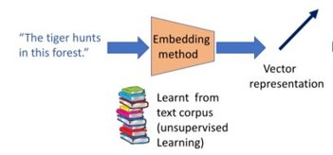
Text Embedding -​ Uses a fixed-dimensional vector to represent a small piece of text​ ​ ​
A bi-directional Long Short-Term Memory (LSTM) that extracts semantic vectors from the text description. ​
The two hidden states (one in each direction) of the LSTM model are concatenated to represent the semantic meaning of a word.​
The last hidden states of the bi-directional LSTM are concatenated to be the global sentence vector​
Source - Internet

Slide 13
State-of-the-art OP-GAN
This is a conditional-GAN (cGAN) framework, in which both the generator and the discriminator gets additional information, such as labels and captions, as input.
Hence, this is a supervised image generation model which requires more than image caption to generate image
Consist of two streams – Object pathway and Global pathway
Artificial Intelligence enabled Image Generation from text
Notes:
The CSU Graduation 2025 Initiative guides resource discussions at the system and state level
Focus is now on four-year graduation rates: see California Promise

Slide 14
OP-GAN (Continued..)
Label/Object extraction from caption. The labels are one hot encoded vectors.
A child is playing with a ball on the lawn
Child (Person)
Label(i)...
Lawn
Notes:
There are total of 80 objects present in MS-COCO dataset

Slide 15
Preprocessing in Generator Network
Randomly sampled noise vector
Location and size of individual bounding boxes
Concatenation to get label(i)
Generator Network
Image caption embedding
Notes:
concatenate the image caption embedding φ and the one-hot vector of a given bounding box lonehoti and create a new label embedding labeli by applying a matrix-multiplication followed by a non-linearity (i.e., a fully connected layer).

Slide 16
Global Pathway
Creates general layout for the global scene
Replicate to the bbox location in Image layout
Concatenated with image caption and noise vector
Labels(i)
Layout encoding
Global features (fglobal)
Applied convolution layers
Notes:
Typically in this architecture we use GLU as activation function for all the Convolution layers
In areas where the bbox overalap the label embeddings are summed up.
In areas with no bbox, remains zero

Slide 17
Object Pathway
Generates features of objects
Empty canvas
Objects features
Replicate using Conv layers
Object feature map (predefined resolution)
…..
flocal
flocaln
Label(i)
Loop for all labels
Apply STN to fit into the bbox location

Slide 18
Final Image
…..
Global features (fglobal)
Up-sampling block
Tanh Activation
flocal1
flocaln
Final Image

Slide 19
Discriminator
Input: ​
Original/Generated image.​
location and size of bounding box.​
labels of bounding box.​
Global Pathway: ​
Takes in the image as input and generates global features.​
Object Pathway:​
Takes in the image as input and extracts the objects.​
Concatenates extracted features of objects with bounding box labels.​
Replicates the object in the bounding box.​
​Implemented Spectral Normalization.
Output: Concatenates outputs of Global and Object Pathways and Classifies image as either real or artificial.​

Slide 20



High Level architecture of OP-GAN
D1 (64x64)
D2 (128x128)
D3 (256x256)
G1 (64x64)
G2 (128x128)
G3 (256x256)

Slide 21
Challenges in training GAN
OP-GAN model is big in terms of network size and thereby consuming huge amount of memory for weights.
Train images are high resolution which further restricts the batch size to much lower value. (Usually GPU memory is 16GB)
Lesser batch size causes more time to model convergence.
Discriminator may learn too fast/too slow and cause training instability

Slide 22
Solution - Model Improvement
Introduced Spectral normalization layer in discriminator to replace the 2D batch norm layer.
This constraints the Lipschitz constant of the convolutional filters.
Helps to overcome the limitations of lower batch size and improved stability in discriminator.
Notes:
The Lipschitz constant is the maximum ratio between variations in the output space and variations in the input space of f and thus is a measure of sensitivity of the function with respect to input perturbations

Slide 23
Challenges to Train GAN model
SJSU HPC. Some limitations are
Time limit for normal users in GPU nodes.
Condo nodes (has no time limit) are not available to normal users.
Too low GPU memory to load a sufficiently bigger batch size
Microsoft Azure – Provisioned a single node GPU with NVIDIA Tesla K80.
Training time is too high. Take approximately 26 hours to train single epoch.

Slide 24

Solution – Paperspace Gradient
Provision a single node GPU machine with Nvidia Tesla v100.
Added 100GB SSD to improve the I/O performance.

Slide 25
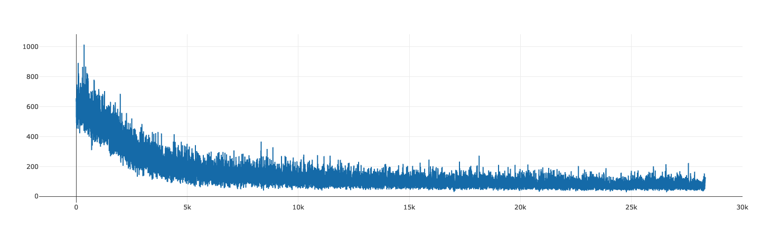
MLops using MLflow
Extensively used MLflow's Tracking API to log the metrics and model hyper-parameters

Slide 26

Evaluation Metrics
Current Evaluation Metrics​​
Inception Score and Fréchet Inception Distance​.
IS: This metric focuses on two things, how distinct an object in each image (I.e., whether generated images contain a clearly recognizable object ) and variety of objects from overall image generated by GAN (I.e., whether the model can generate images of many different object categories).
FID: Calculates the distance between real and generated images.​
Drawbacks:​
They both does not take image caption into account while evaluating the generated images.
They both rely on CNN pretrained on ImageNet dataset, and is completely different from MS-COCO dataset.
Generated image contains single object
InceptionNet pre-trained on ImageNet
Probability of image in each class

Slide 27

Evaluation Metrics
​VS Similarity and R-Precision​​
Visual Semantic Similarity: Measures the distance between generated image and caption.​
R-precision: Performs ranking of the similarity between real caption and randomly sampled captions for a given generated image.​
​
​
​
Drawback:
These two metrics do not evaluate the quality of individual objects.
Models might overfit to the evaluation metric during training.
Images are evaluated based on background characteristics.
"A person eating pizza"
Calculates cosine similarity for all the encoded pair.
Rank similarities.
R-precision score

Slide 28
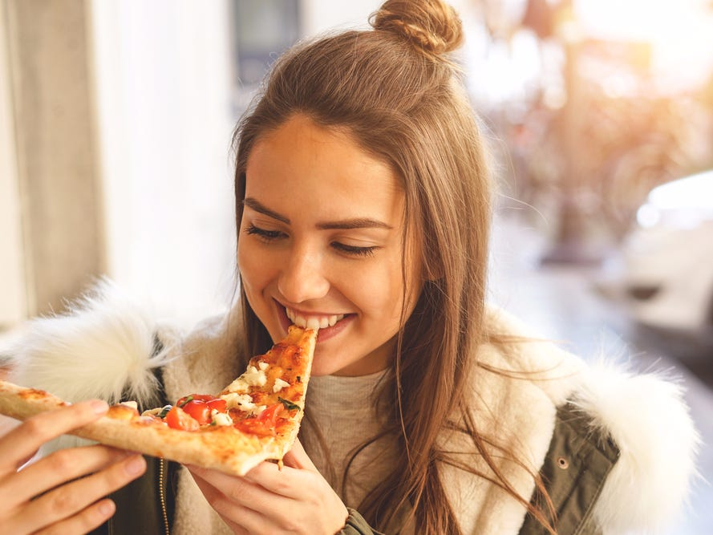
Semantic​ Object Accuracy
To address the challenges and issue mentioned above. ​
We use one of the novel evaluation metric based on pretrained object detector network.​
SOA addresses three main problems,​
Takes image caption into account.​
Pre-trained object detector on same domain.​
Focuses on foreground object.
R-: Performs ranking of the similarity between real caption and randomly sampled captions for a given generated image.
"A person eating a pizza"
Person
YOLOv3 Network
Pizza

Slide 29
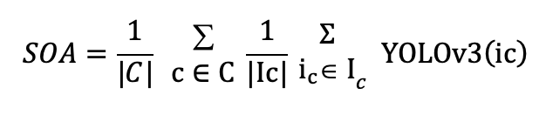
Semantic Object Accuracy
How this SOA works?​
For each of the 80 objects (person, dog, chair, bulb etc) that is given as label in MS-COCO dataset, all the captions are retrieved, and three images are generated for each caption.​
Ex. Captions (person, woman, man) -> Label (person) and caption (monitor, tv, screen) -> Label(monitor)​
Generated images are given as input to pretrained object detector to identify the objects in generated images.​
For each label calculate how often the specific object was detected in the generated images for this label. (We get 80 individual results as there are 80 labels in MS-COCO dataset)
SOA: The SOA score gives us the true positives of a generated image,​
Accuracy Score : Calculate the average accuracy for overall classes in a dataset.​
Notes:
Where, C belongs to object classes and Ic, images must contain an object of class c​
YOLOV3 -> returns 1 if an object is detected otherwise 0.

Slide 30
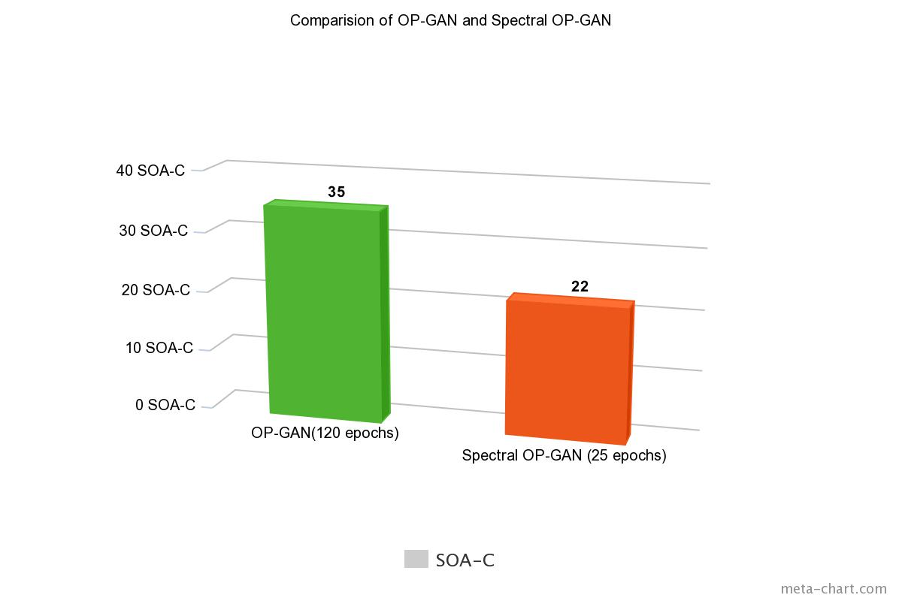
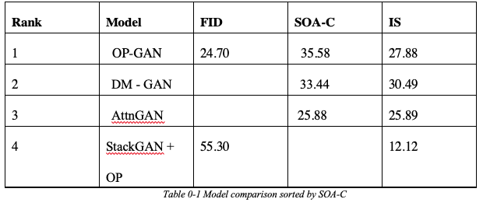
Semantic​ Object Accuracy
Result: We were able to achieve Semantic Object Accuracy score of 22 in 25 epochs compared to previous model which achieves 35 in 120 epochs.​

Slide 31
Demo

Slide 32
For more information:
Sivaranjani Kumar (sivaranjani.kumar@sjsu.edu)
Akshaya Nagarajan(akshaya.nagarajan@sjsu.edu)
Pooja Patil(pooja.patil@sjsu.edu)
Vignesh Kumar Thangarajan(vigneshkumar.thangarajan@sjsu.edu)

Slide 33
Thank You

